Slide 1
METAGENOMIC BINNING USING METABAT 2
ECES-650/450:
TUTORIAL 7
ADITYA SHAH
MRIDUL AWASTHI

Slide 2
REVIEW OF METAGENOMICS AND ASSEMBLY
Metagenomics
Study of genetic materials from a mixed community of organisms.
Analyzing genomes of microorganisms present in environments where it may not be possible differentiate between organisms.
May not be possible to obtain cultured samples in order to study the community of microorganisms present and find out how they are related.
Assembly
Computational step to reconstruct the genome from its reads, after sequencing.
Stiches together smaller genomic sequences into larger pieces (contigs, scaffolds, etc.).

Slide 3
INTRODUCTION TO METAGENOMIC BINNING
Binning
In metagenomics, binning is the process of grouping reads or contigs and assigning them to individual genome “bin” that they most closely relate to. [1]
Modern tools assemble billions of short sequence reads derived from deep metagenome sequencing into larger fragments (contigs), and subsequently group them into draft genome containers by metagenome binning.
Challenges
Binning of the assembled contigs or unassembled reads is a major bottleneck and existing methods are slow, produce poor results, are error prone, and are based on non-standard platforms. [2]
“…one reason for this is the lack of accurate quality evaluation reports of binning results. “ As such “…a general standard for comparing binning results is necessary.” [3]
CAMI is a community-led initiative to address this standardization. The community helps “compare metagenomic tools independently and comprehensively” including several binning tools. [3]

Slide 4
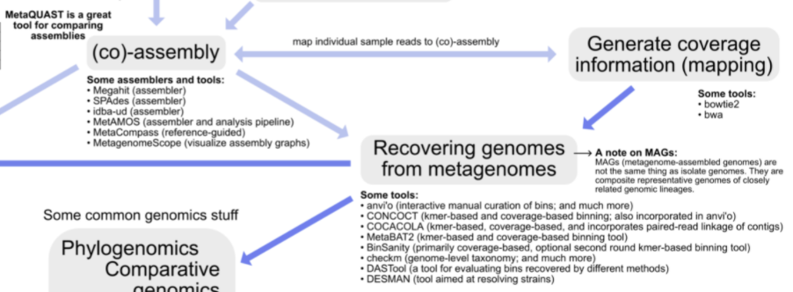
BINNING IN THE GENERIC METAGENOMIC WORKFLOW
Mapping metagenomic binning in a generic metagenomic workflow.
Overview of generic* metagenomic workflow [4]

Slide 5
TOOLS FOR METAGENOMIC BINNING
Purpose of binning tools:
Adaptive algorithms to categorize genomes from mixed microbial communities to the associated microbial species. [1]
Various binning tools [2]:
Taxanomic Binning (i.e., matches sequence against an existing database):
Using alignment algorithms such as blast, bowtie, bwa, minimap, etc.
Genomic Binning (unsupervised method, sometimes using machine learning):
GroopM, MetaBat 1/2, MaxBin, MetaWatt, Autometa, etc.
In this tutorial, we explore MetaBat 2.

Slide 6
INTRODUCTION TO METABAT2
Use case:
Automated binning tool based on abundance and tetraneuclotide frequency.
Developed jointly by the DOE, Lawrence Berkley National Laboratory, University of Science and Technology of China.
MetaBat1
Fastest and most robust algorithm but not the most accurate (CAMI challenge).
Many parameters to manually optimize, thus lack of consistent binning performance.
Optimized for larger contigs (>2500 bases).
MetaBat2
New algorithm to address the accuracy issues with MetaBat1.
Parameters optimized by default and based on a standardized data set – this is the time limiting step in the algorithm.
Allows for smaller contigs to be used (<200 bases).
Improves computational efficiency thus gained efficiencies in computation power and memory usage.

Slide 7
INTERACTING WITH METABAT2
Input and Output Files:
Input:
Fasta file with assembled contigs.
Depth file: mean and variance of base coverage depth.
Output: Fasta file for each “binnedcontig”.
Contig Parameters:
Minimum size of contigs
Minimum edge score
Edges per node
Binning for lost contigs
Mean coverage of contigs
Bin Parameters:
Minimum size of bin

Slide 8
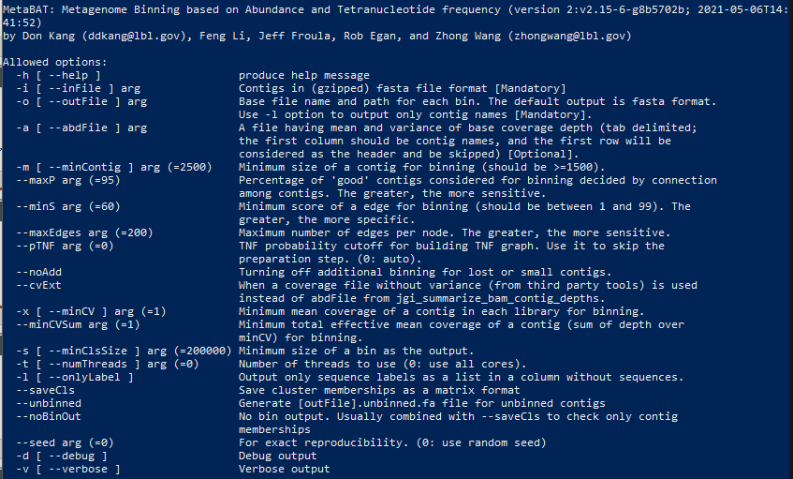
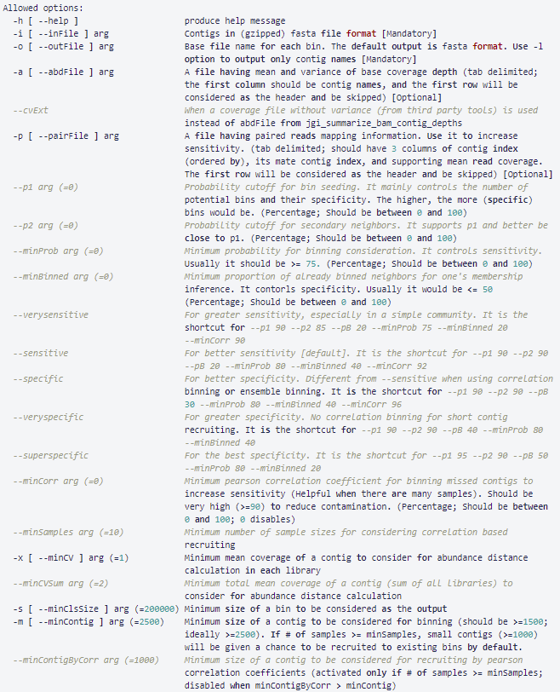
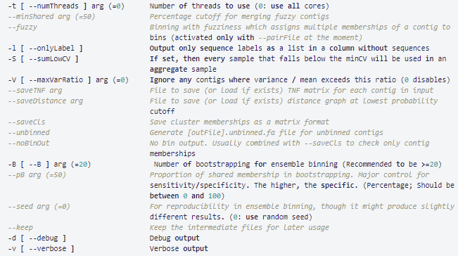
METABAT2 VS METABAT1 PARAMETER OPTIMIZATION

Slide 9

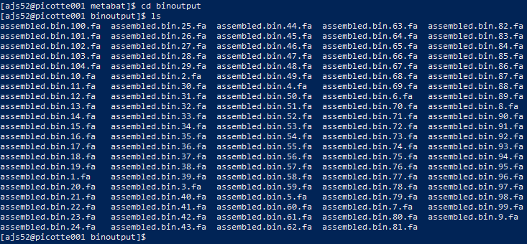
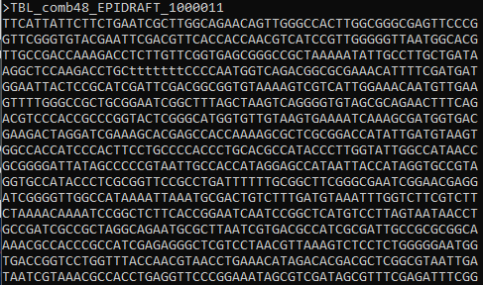
INTERACTING WITH METABAT:
MetaBat2 Pipeline Input
Assembled.bin.2.fa
MetaBat2 Pipeline Output

Slide 10
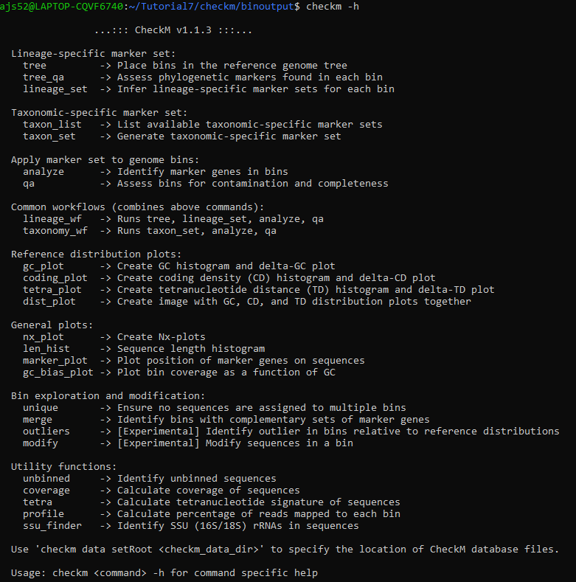
ANALYZING BINNING DATA
CheckM [5]:
Quality of genomes recovered from assembly data.
Estimate of genome completeness and contamination data.
Analysis using charts and graphs.

Slide 11
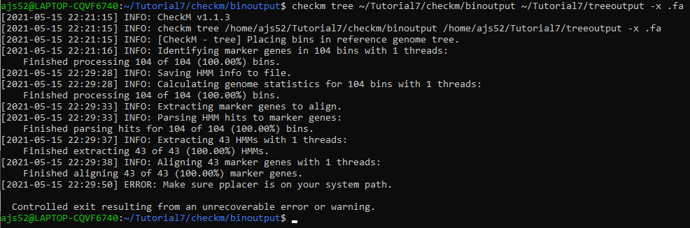
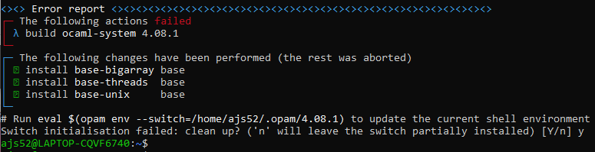
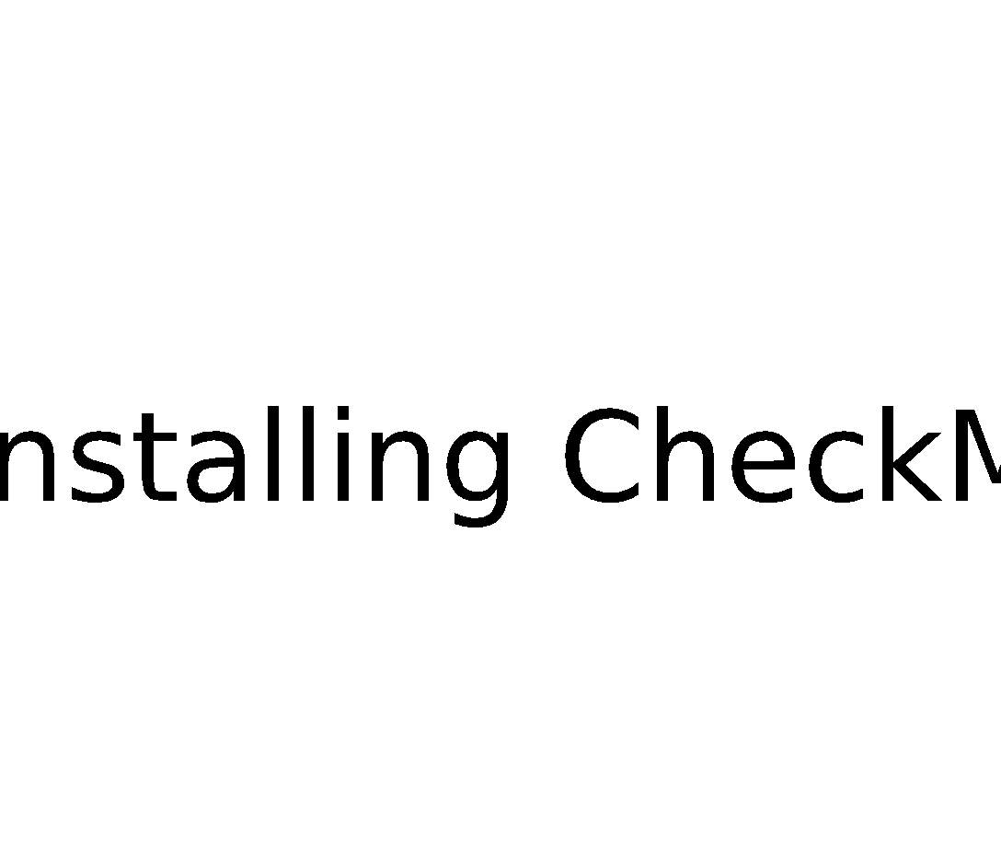
INTERACTING WITH CHECKM
Running CheckM:
Long and complicated installation process.
We have prepared a guide on installation (incomplete).
Over 40 hours of effort with no results.
pplacer related issues:
Many dependencies
Especially with OCAML switches.

Slide 12
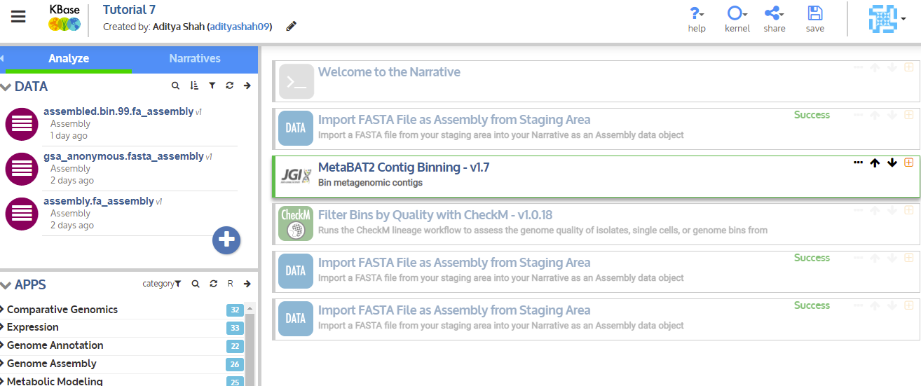
CHECKM ALTERNATIVE #1: KBASE
Easy to use; create a pipeline as follows
Binning tool requires read files that were not available
CheckM in KBase is not able to read the .bin.xx.fa bin files as binned contigs
Works best if the whole pipeline is used in KBase, from reads to binning.

Slide 13
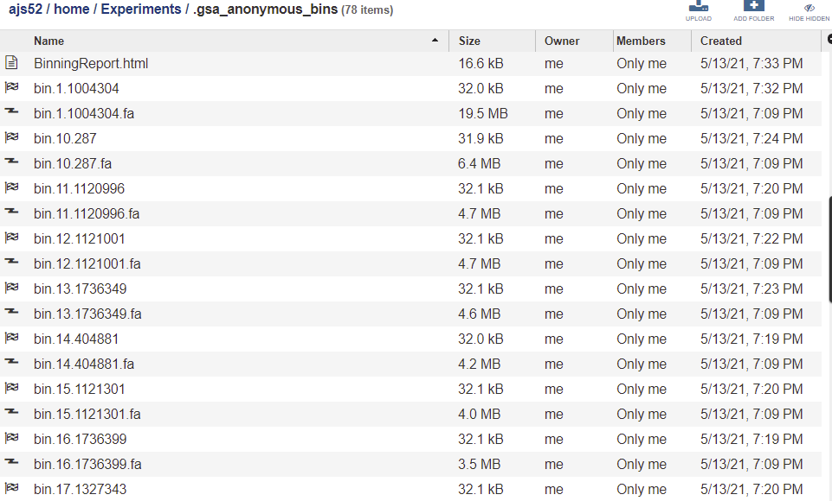
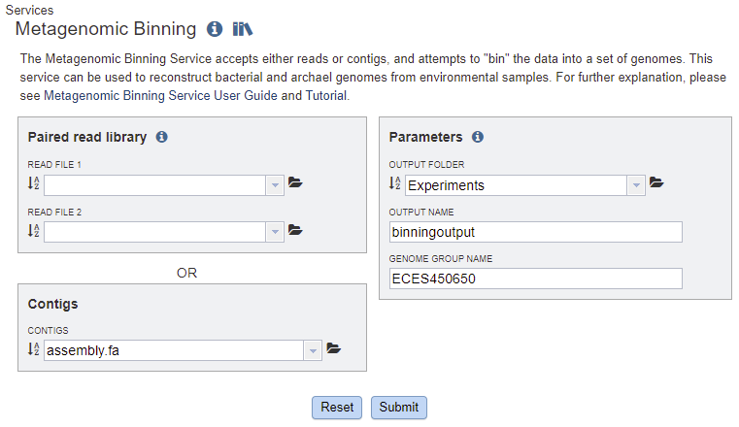
CHECKM ALTERNATIVE #2: PATRIC
Pipeline includes Binning and analysis automatically.
Analysis based on CheckM algorithms.

Slide 14
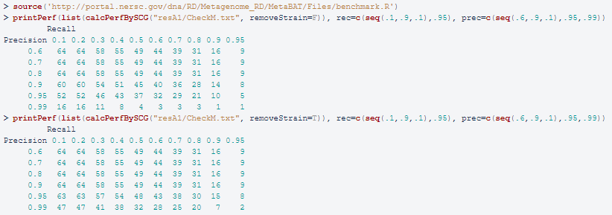
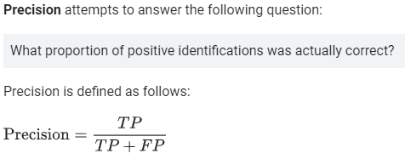
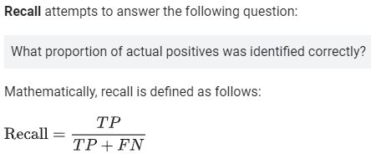
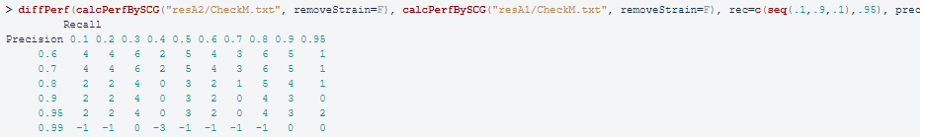
EXPECTED RESULTS FROM CHECKM USING R FOR ANALYSIS
Recall: CheckM is used for completeness and contamination data.
calcPerfBySCG function in R to analyze the CheckM file.
Recall and Precision data.
diffPerf(calcPerbySCG) or two different results.

Slide 15
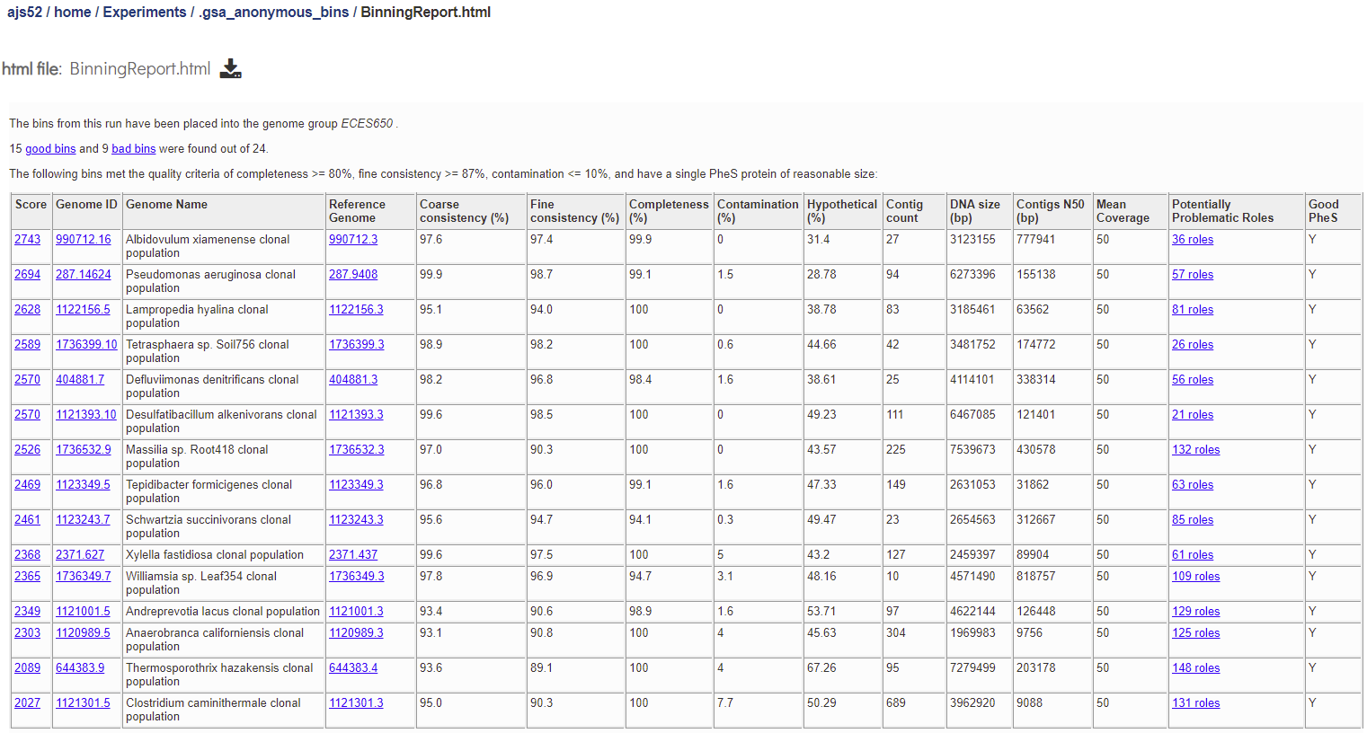
RESULTS FROM PATRIC

Slide 16
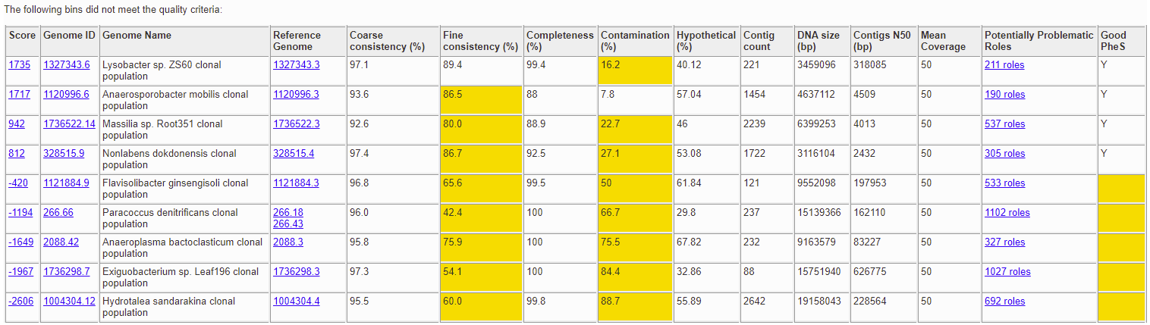
RESULTS FROM PATRIC CONT’D:

Slide 17
REFERENCES
[1] Dongwan D. Kang, Feng Li, Edward Kiroton, Ashleigh Thomas, Rob Egan, Hong An, Zhong Wang. “MetaBAT 2: an adaptive binning algorithm for robust and efficient genome reconstruction from metagenome assemblies”. Peerj – Life & Environment (2019). url: https://peerj.com/articles/7359/
[2] Yue, Y., Huang, H., Qi, Z. et al. Evaluating metagenomics tools for genome binning with real metagenomic datasets and CAMI datasets. BMC Bioinformatics 21, 334 (2020). https://doi.org/10.1186/s12859-020-03667-3
[3] Marc Strous, Beate Kraft, Regina Bisdorf, Halina E. Tegetmeyer. “The binning of metagenomic contigs for microbial physiology of mixed cultures”. Front. Microbiol. (2012). url: https://www.frontiersin.org/articles/10.3389/fmicb.2012.00410/full
[4] Lee, Michael D., “Assembling a metagenome and recovering “genomes” with Anvi’o”, Happy Belly Informatics (2019). url.: https://astrobiomike.github.io/genomics/metagen_anvio#building-up-our-contigs-database
[5] Donovan H. Parks, Michael Imelfort, Connor T. Skennerton, Philip Hugenholtz, Gene W. Tyson. “CheckM: assessing the quality of microbial genomes recovered from isolates, single cells, and metagenomes”. (2015). url: https://genome.cshlp.org/content/25/7/1043.full doi: 10.1101/gr.186072.114

